Slide 1



Shri Ramswaroop Memorial University
The Silver Screen Symphony
Data Analytics & Reporting Project
By Inzmam un Nabi Khan (202410101150099) & Alok Shrivastaw (202410101150096)
Group : 34 | Course/Branch : Btech CS(DS + AI)
Year/Sem : 2nd year, 3rd Sem | Subject : Data Analytics & Reporting (UCS3804)

Slide 2


OBJECTIVE
To Provide Driven Insights for Modern Streaming World
The challenge of modern data analysis is transforming large volumes of raw data into reliable, actionable insights.
This project documents a hybrid workflow combining Microsoft Excel, Python, and Power BI to demonstrate a practical, end-to-end methodology.
Excel: Used for immediate data inspection, crucial quality control, and rapid preliminary summary statistics.
Python: Utilized for scalability, rigorous cleaning (Pandas), complex aggregation, and professional statistical visualization (Matplotlib).
Power BI: Leveraged for building an interactive Business Intelligence report to consolidate and present findings.

Slide 3


Excel Methodology
Data Acquisition & Preprocessing
Analysis & Reporting
Primary dataset acquired from the public IMDb repository.
A Pivot Table was constructed to summarize the data, aggregating the total count of movie releases by year.
Conditional formatting applied to systematically highlight and isolate missing or null entries.
The resulting time-series data was visualized using a Line Chart.
Missing numerical values addressed using mean imputation to maintain sample size and minimize bias.
This chart represents the historical trend of movie production, allowing for clear observation of release volumes.

Slide 4

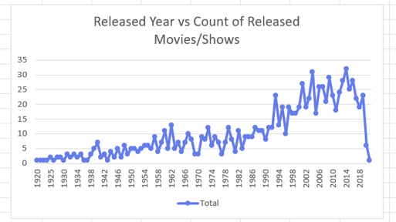
Insights from Excel
Movie Production Trends
1920-1990 (Slow Growth): Stable, low volume of 1-15 releases per year.
Post-1990 (Production Boom): A dramatic and sustained increase in releases.
2000-2017 (Peak Production): The highest counts and volatility, with peaks in 2004 (31) and 2014 (32).
Post-2018 (Recent Dip): A sharp decline, possibly due to data lag or external factors.

Slide 5

Python Methodology
Data Ingestion & Wrangling
Exploratory Data Visualization
Data ingestion performed using the Pandas library, establishing a DataFrame structure.
Bivariate Analysis (Scatter Plot): Visualized the distribution of movies based on Gross Revenue and IMDb Rating to find correlation.
Comprehensive quality checks implemented.
fillna() applied to perform mean imputation on specific columns.
Categorical Analysis (Bar Plot): Generated to compare mean IMDb Rating across different movie certification categories.
dropna() used to systematically remove rows containing null values that could not be logically imputed.
Correlation Matrix (Heatmap): Displayed to assess linear relationships between all numerical variable pairs.

Slide 6

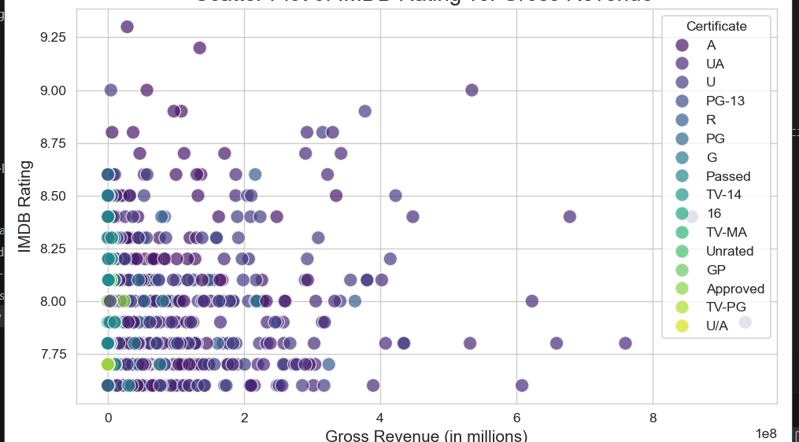
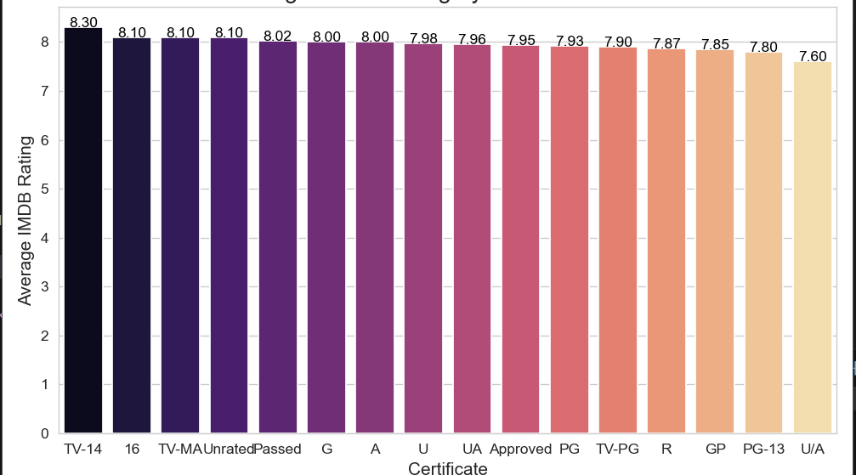
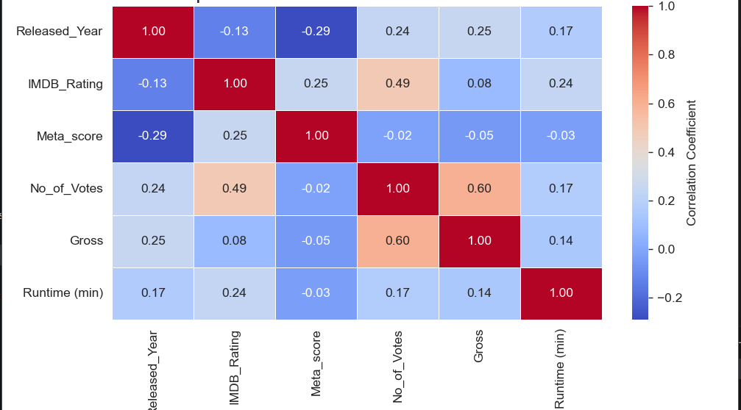
Insights from Python
Scatter Plot: IMDb rating is not a primary predictor of Gross Revenue. Commercial success is decoupled from critical acclaim.
Bar Plot: Mature content (e.g., 'TV-14', '16', 'TV-MA') achieves higher average IMDb ratings than general audience films.
Heatmap: The strongest positive correlation (0.60) is between No_of_Votes and Gross Revenue.

Slide 7

Power BI Methodology
Data Model Preparation
Dashboard Visualization
The cleaned and processed dataset was imported into the Power BI environment.
Key Performance Indicator (KPI) Cards: Implemented for immediate visibility into the main performance metrics.
Data Analysis Expressions (DAX) measures were defined for key metrics:
Genre Performance (Line Chart): Created to visualize Total Gross Billions by Genre, identifying high-performing markets.
Weighted Average Rating
Total Gross Billions
Performance Distribution (Scatter Plot): Developed to map the relationship between IMDb Rating and Total Gross Billions.

Slide 8
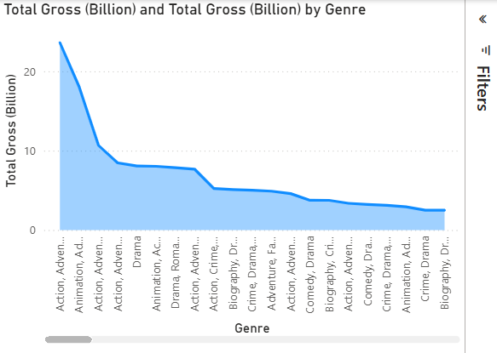
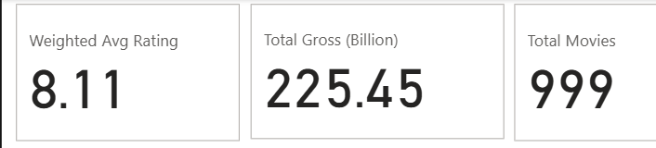
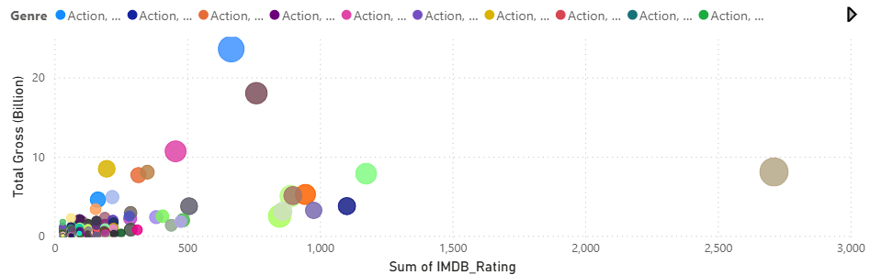
Insights from Power BI
KPI Cards: Confirmed a robust, high-quality dataset of 999 movies with an 8.11 Weighted Avg Rating and $225.45B Total Gross.
Genre Chart: Revenue is highly concentrated. The Action & Adventure genre combination is the undisputed market leader.
Scatter Plot: Commercial success is maximized when high audience engagement (bubble size) intersects with high financial return.

Slide 9


Conclusion & Recommendation
CONCLUSION
Success in the film industry is a function of audience scale, not just critical perfection. While the dataset's 8.11 Weighted Average Rating confirms its high quality, the financial analysis shows that high revenue is most strongly tied to the Number of Votes (Audience Engagement), with a correlation of 0.60.
RECOMMENDATION
Future investment should strategically focus on producing films within the Action and Adventure genre combination. Simultaneously, marketing strategies must be aimed at maximizing audience engagement and vote volume, as these metrics are the most reliable indicators for achieving high gross revenue.

